Slide 1
CS275 Final Project Demo
Matt Horger, Adam Faggen, Duy Nguyen

Slide 2

Our Project
Jeopardy multiplayer game
Intended for couch party play
1 Host, 3 Participants
Tried to replicate all core game mechanics for timeline of this project

Slide 3
Technologies Used
HTML - Backbone of our webpage
CSS - Styles used for Jeopardy Game Board colors, game sounds
JavaScript - language used to process game information (questions, player score, etc)
Framework used - Angular
JSON - Format used to parse question table from API results
Ajax - Mechanism used for API calls
API’s used - http://jservice.io/, custom-made Node.JS -> SQL connector
Node.js - used to serve webpage, bridge between MySQL and Client
MySQL - used to store player information and score

Slide 4


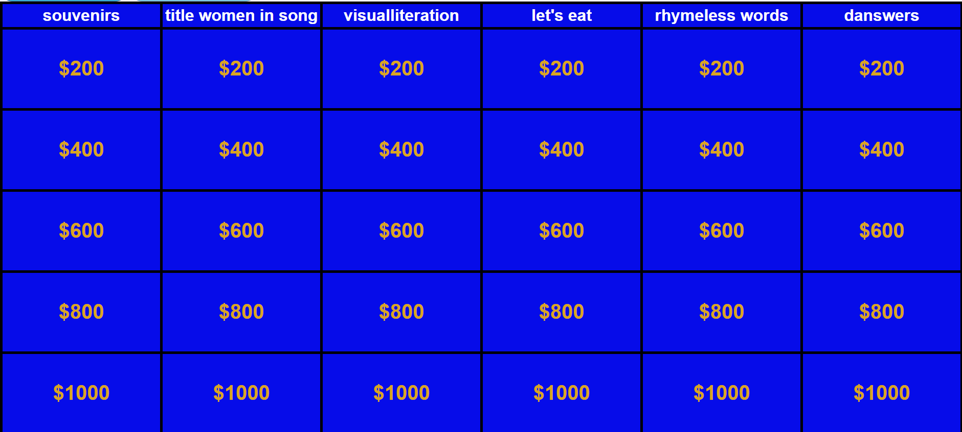
Project Poster
Faggen, Horger, Nguyen
A 4-Person Couch Multiplayer game built using AngularJS/MySQL based on the classic television series hosted by Alex Trebek.

Slide 5
Code Demonstration

